Slide 1
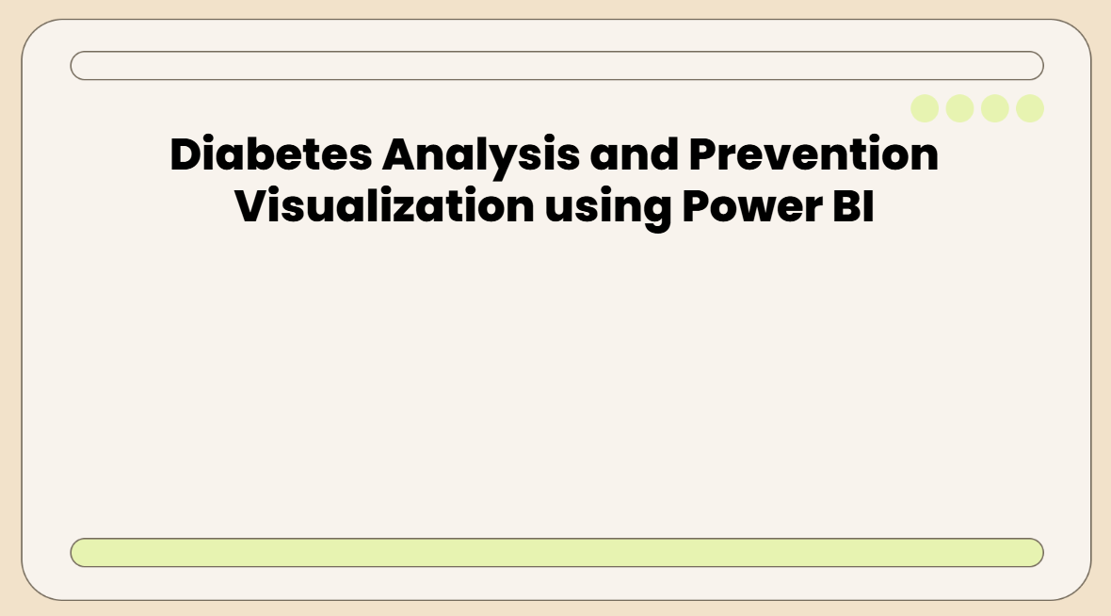

Slide 2
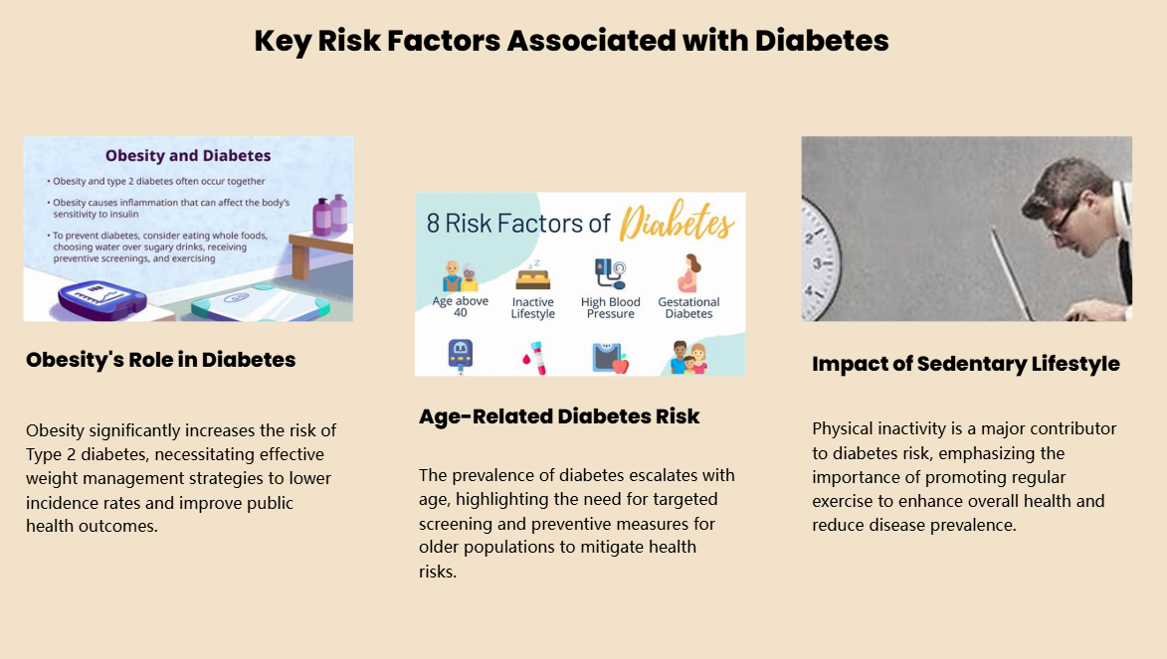

Slide 3
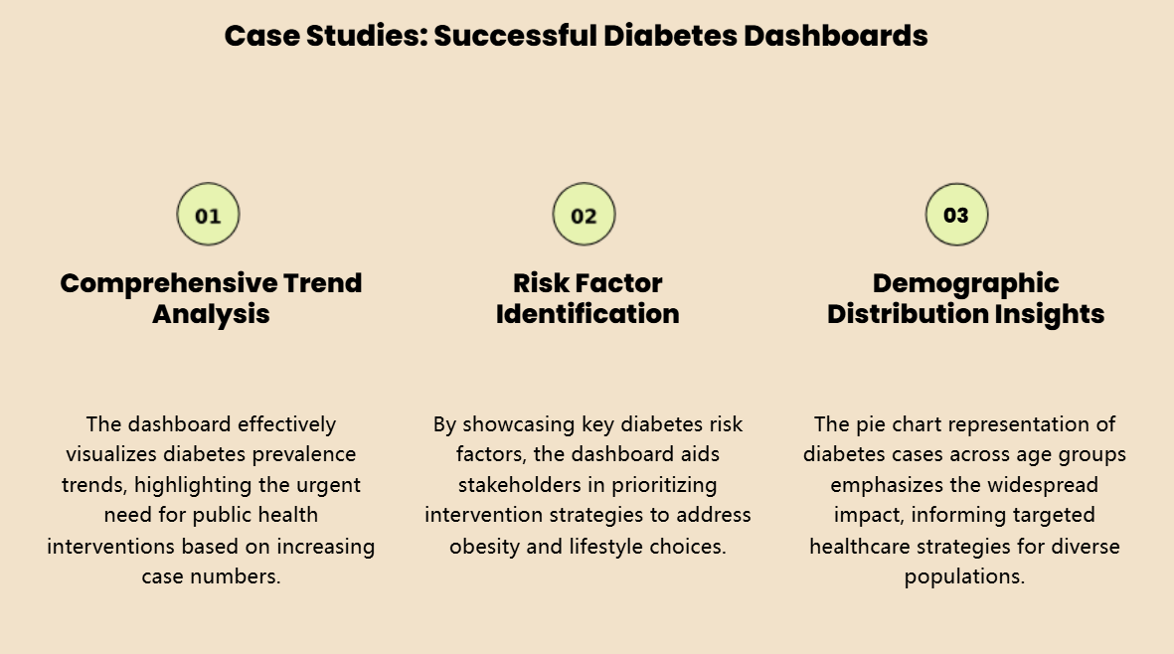

Slide 4


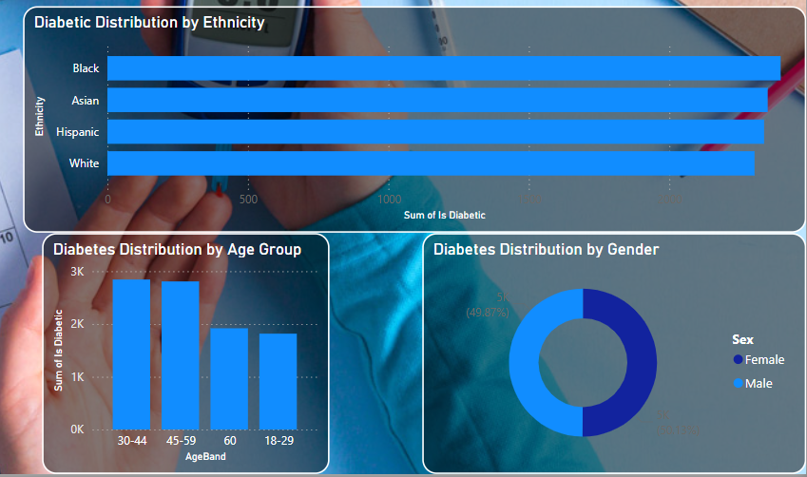
This screen presents a high-level overview of diabetic trends across the population.
With an average BMI of 29.18, the population hovers on the brink of obesity
The average fasting glucose (132.48 mg/dL) places most individuals in the prediabetic zone
Alarmingly, 85% of the sample is already classified as diabetic
Ethnic distribution reveals a uniformly high prevalence, with Hispanic and Black groups showing slightly elevated counts.
The 30–44 age group carries the highest diabetic burden — a critical target for prevention efforts.
Gender-wise, the split is nearly even, underscoring that diabetes is a universal risk, not gendered.

Slide 5
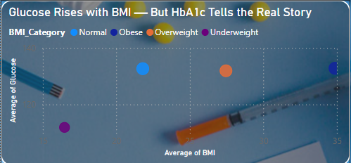
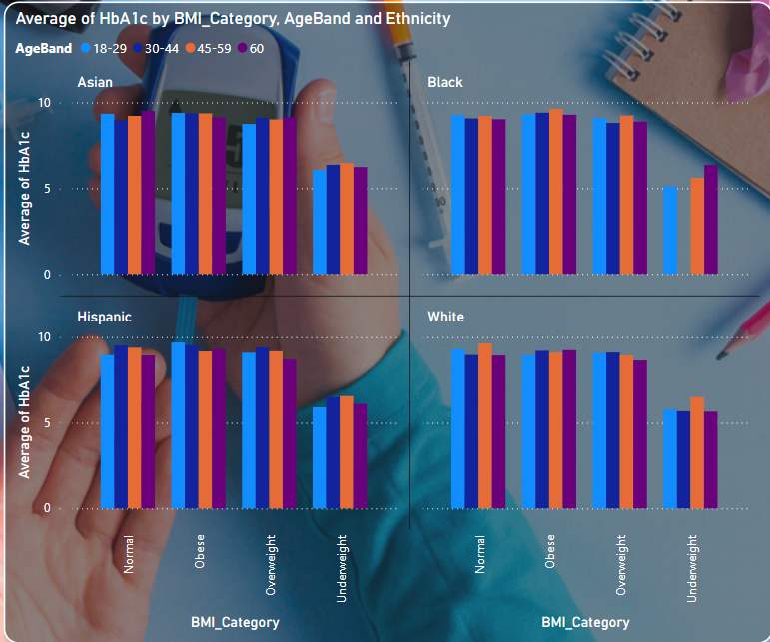
While glucose levels generally increase with BMI, HbA1c tells the real story — revealing elevated chronic risk even in normal and overweight groups.
Ethnic differences are notable, with certain populations showing high baseline risk regardless of weight or age group.
The takeaway: screening should go beyond weight, and focus on hidden metabolic trends.

Slide 6
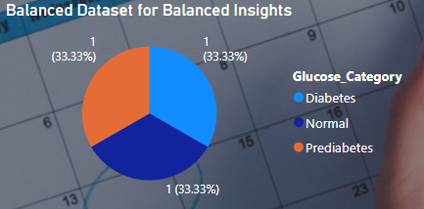
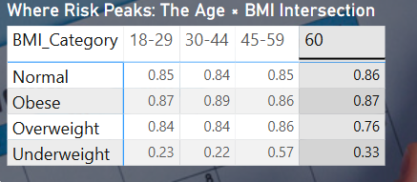
Balanced Dataset for Balanced Insights
To ensure fairness, generalizability, and unbiased predictions in our model, we’ve constructed a balanced dataset across all diagnostic stages — Normal, Prediabetes, and Diabetes.
This balance ensures that our classification and predictive models do not favor any one class, and remain robust for early detection as well as advanced diagnosis.
The matrix highlights the intersectional risk pattern:
Obese individuals aged 30–44 show the highest diabetic prevalence (89%)
Even normal BMI individuals show consistently high risk (~85%) in all age bands — challenging traditional BMI-based assumptions
Underweight seniors (60+) carry a non-trivial risk (33%), reinforcing the idea that diabetes doesn’t always follow expected visual cues

Slide 7

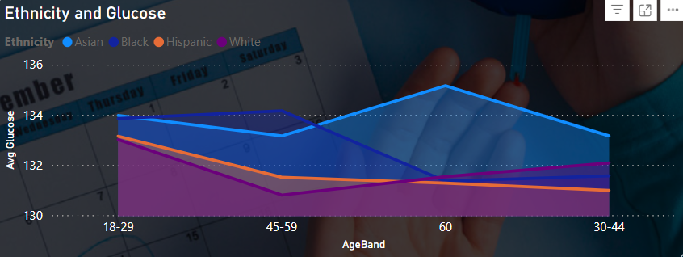
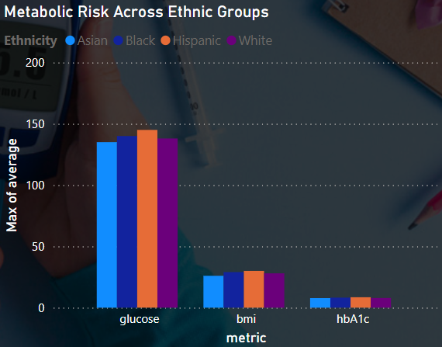
This bar chart displays the total number of diabetic individuals in each age group.
The 30–44 age bracket has the highest diabetic count, followed closely by 45–59. These mid-life stages are a critical window for intervention, especially as risk tends to accumulate silently
Glucose levels vary across age and ethnicity.
Hispanic and Black populations show noticeable glucose spikes around age 60, while others remain more stable. This chart supports the idea that ethnicity influences metabolic change with age, and that screening protocols should be demographically aware.
Here we compare the maximum average values for three core metabolic indicators across ethnicities.
The Hispanic group leads in both Glucose and BMI, followed by Black populations. Interestingly, HbA1c is elevated across all groups, indicating long-term sugar exposure is widespread

Slide 8
Conclusion & Strategic Outlook
🔍 What We Discovered
Diabetes is no longer just a disease of obesity — normal-weight individuals show elevated HbA1c and glucose across ethnicities.
Age 30–59 is the epicenter of diabetic volume, highlighting the need for mid-life screening.
Low physical activity and heavy alcohol use is the most dangerous lifestyle combination (91% diabetic rate).
Ethnicity influences risk across all metrics — but chronic elevation (HbA1c) is present across the board.
🛡️ Preventive Measures & Actionable Recommendations
✅ Early Screening for All Adults (Not Just Obese) Even individuals with normal BMI may be at hidden risk.
✅ Lifestyle-Focused Public Health Campaigns Promote moderate activity and alcohol control, especially for age 30+.
✅ Culturally Aware Outreach Hispanic and Black populations may need tailored preventive strategies based on consistent glucose and BMI elevations.

Slide 9
📊 Why This Dashboard Matters
Interactive: Enables doctors, data scientists, or policymakers to slice by age, BMI, ethnicity, and behavior instantly.
Insight-Driven: Not just charts — real, story-driven exploration of risk from multiple dimensions.
Industry-Ready:
For public health agencies: to plan awareness programs.
For healthtech startups: to develop smarter diagnostic models.
For hospitals: to use in preventive risk scoring dashboards.

Slide 10
Thank you

